Slide 1
Welcome-PS 108 TOWN HALL MEETING
AUGUST 12, 2020
6pm

Slide 2
Agenda
Preparing for Returning to School (2020-21)
Health and Safety
Chancellor’s Models (Blended Learning or Remote Learning)
Parent Selection
  Blended
  Remote
School Readiness
Teaching and Learning
Student Schedules
Getting Ready for School

Slide 3
Guiding Principals (slide 1)
Our planning for the 2020-21 School Year centers on key values that guide all our work and decision-making. They are:
Physical and mental health of our students, teachers, staff, and families;
Greater equity among students with respect to the education they receive and the learning environment in which they receive it—whether virtual or in-person;
Academic achievement for students through high-quality instruction, tailored enrichment, and culturally responsive educational practices that allow students to see themselves reflected in the materials and lessons of their education;
Social-emotional and trauma-informed support for all students;
Community and continuity all year among students, and between students and teachers/staff;
Priority support for students and families who have trouble accessing and engaging in remote learning;

Slide 4
Guiding Principals (slide 2)
Our planning for the 2020-21 School Year centers on key values that guide all our work and decision-making. They are:
Deeper empowerment of our families as essential partners in their children’s education
Frequent, consistent, and transparent communication with families, schools, and partners;
Clear guidance for schools in balance with the necessary flexibility to meet the needs of their particular school community; and
Commitment to continuous improvement; flexibility in response to evolving public health, budgetary, and environmental conditions; and sustained fulfillment of the needs of students, families, and staff.

Slide 5
Health and Safety-Opening the School
Thresholds for Opening and Closing Schools
Building Preparations Prior to Schools Reopening
Food Services
Building Safety Measures
Testing and Tracing
Personal Health Measures

Slide 6
Thresholds for Opening and Closing Schools
Threshold for Reopening Schools In order for schools to reopen, New York City must meet the following:
The percent of positive tests in New York City is less than 3% using a 7-day rolling average. If we cross this threshold, we will not reopen.
Threshold for Closing Schools Schools will need to close if New York City meets the following:
The percent of positive tests in New York City is equal to or greater than 3% using a 7-day rolling average. If we cross this threshold, schools will close.

Slide 7
Building Preparations Prior to Schools Reopening
At the start of the school year, the DOE will provide all schools with necessary supplies to help protect students and staff from COVID-19, including hand sanitizer, soap, disinfectants, and thermometers.
DOE will make the maximum number of sinks available for handwashing.
DOE will make improvements to HVAC systems, as well as air conditioning repairs, to improve air circulation, as well as replacing regular air filters with higher efficiency types.
DOE will increase cleaning throughout the school day, with special attention to high-touch areas.

Slide 8
Food Services
Students can’t learn if they aren’t nourished. Grab-and-go meals will be available for breakfast and lunch each day, though students will also be permitted to bring their own lunch if preferred. Doing so will allow for more flexibility so students and physical distancing can be maintained during lunch time, a time when many students usually gather in one location.
Lunch will be in classrooms to minimize interaction between groups of students.
If the cafeteria must be used, schools should maintain appropriate physical distancing.
Grab-and-go meals will be delivered to students in 3K to K classrooms, and pickup points within the school will be designated for grades 1-12.

Slide 9
Building Safety Measures
Maintaining Healthy Environments
Keeping students and staff safe requires that the physical environment in which our staff works and our students learn must be modified to meet current health and safety needs.
Changes to School Buildings
Schools will be allowed, and in some cases directed, to modify or reconfigure spaces to ensure compliance with physical distancing rules. Additional guidance on the process for space modifications will be shared later this summer.
All schools will have a designated Isolation Room, as well as staff to supervise that space.
School Based Health Centers (SBHC) may provide supplemental care, if this is a viable option.

Slide 10
Building Safety Measures
Cleaning and Disinfection Schools will need to implement enhanced cleaning and disinfection of surfaces to ensure the health and safety of staff and students. Throughout the school year, the DOE will continue the rigorous practices used to prepare buildings for reopening, including:
Providing adequate cleaning and disinfection supplies or plan to procure those supplies.
Requiring deep cleanings to be completed on a nightly basis, including with the use of electrostatic sprayers.
Improving HVAC systems to ensure proper ventilation.
Setting-up enhanced cleaning in classrooms, bathrooms, and for high touch areas such as doorknobs and shared equipment such as laptops.
Providing teachers with cleaning supplies for classrooms.

Slide 11
Building Safety Measures
Screening and Entry/Dismissal Protocols - In order to minimize the number of individuals who come in contact with each other, and in order to identify potentially sick students and staff to the greatest extent possible, schools will be required to follow all applicable health guidance and to develop entry and dismissal protocols consistent with the latest health guidance, including:
Staying up-to-date on guidance on symptom checks, which continues to evolve.
Screening staff, students, and visitors daily on arrival for symptoms.
Creating guidelines for health screenings of staff who report to work outside of morning arrival.
Managing student drop off and pick up outside the school building to minimize the number of external visitors.
  It is strongly recommended that nonessential visitors do not enter the school building. Schools should limit the frequency and duration of other visitors.

Slide 12
Building Safety Measures
Movement Protocols Similarly, schools must redesign building movement protocols to keep people in cohorts and allow for physical distancing consistently. In particular, schools are being required, to the extent feasible, to:
Redesign movement protocols within a building to minimize congestion
Designate one-way direction stairwells and single file routes
Signage may be provided to support appropriate movement protocols.
Using Staff to Maintain a Healthy Environment
With health and safety as a priority, it will be important to have staff dedicated to carry out enhanced health operations:
Use the Building Response Team structure to develop a school-based COVID-19 team.
Deploy adequate staff to support with daily enhanced health protocols.

Slide 13
Testing and Tracing
We must use every effort to prevent the spread of infection in schools if a student or staff member is feeling sick or has a confirmed case of COVID-19. This section explains the protocols in place to achieve this.
The most fundamental guidance remains that any student or staff member should stay home if they are not feeling well.
The City will continue to closely monitor health conditions, and if community transmission begins to rise across the boroughs, the decision to close all schools may be included in the mitigation effort.
In the interest of the health and safety of our entire city, DOHMH recommends that all New Yorkers get tested, whether or not you have symptoms or are at increased risk.
All staff members will be asked to take a COVID-19 test in the days before the first day of school. School staff will have priority access for testing with tests provided free of charge and with expedited results. This testing is also available for families citywide.

Slide 14
If Someone in the School Community Feels Sick
If a student or teacher is feeling sick, they are required to stay home and, if their symptoms are consistent with COVID-19, are asked to get tested. If a student begins experiencing symptoms in school, they will be isolated and monitored by a dedicated staff member until they are picked up by their family. Staff members who become symptomatic at school are asked to immediately leave the building.
Whether symptoms begin at home or in school, there will be a clear flow of information to facilitate fast action and prevent spread. A positive confirmed case will trigger an investigation by NYC Test + Trace and DOHMH to determine close contacts within the school. Schools will communicate to all families and students at school once a case is laboratory confirmed.
The DOE is working in tight coordination with DOHMH and the Test + Trace Corps to identify, isolate, and prevent spread of COVID-19. In the event that there is a laboratory- confirmed case in a school, all students and teachers in that class are assumed close contacts and will be instructed to self-quarantine for 14 days since their last exposure to that case.

Slide 15
If Someone in the School Community Feels Sick
Additionally, the DOHMH and Test + Trace Corps will begin an investigation into the risk of exposure to the school community and work with the DOE to issue clear guidance and decisions for next steps based on the outcome.
These protocols center the health of our students and staff at the very core of this school year, while pursuing the resumption of in-person learning and educational services. The City will continue to closely monitor health conditions, and if community transmission begins to rise across the boroughs, a decision may be made to close all schools and switch to full-time remote learning.
See scenarios on next slide.

Slide 16
If Someone in the School Community Feels Sick
For all scenarios outlined below, all post-investigation decisions on classroom quarantines or whether full school closure is required will be dependent on the specific facts of each investigation.
Conclusion of Investigation | During Investigation | Post Investigation
A. 1 confirmed case | Close classroom | Classroom remains closed for 14 days; students and staff in close contact with positive case self-quarantine for 14 days.
B. At least 2 cases linked together in school, same classroom | Close Classroom | Classroom remains closed for 14 days; students and staff in close contact with positive cases self-quarantine for 14 days

Slide 17
If Someone in the School Community Feels Sick
Conclusion of Investigation | During Investigation | Post Investigation
C. At least 2 cases linked together in school, different class-rooms | Close School | Classrooms of each case remain closed and quarantined, additional school members are quarantined based on where the exposure was in the school (e.g., the locker room);
D. At least 2 cases linked together by circumstances outside of school (i.e., acquired infection by different setting and source) | Close School | School opens post investigation, classrooms remain closed for 14 days

Slide 18
If Someone in the School Community Feels Sick
Conclusion of Investigation | During Investigation | Post Investigation
E. At least 2 cases not linked but exposure confirmed for each one outside of school setting | Close School | School opens post investigation, classrooms remain closed for 14 days
F. Link unable to be determined | Close School | Close school for 14 days
Whenever a student is quarantining at home, the expectation is that they continue engaging with learning remotely if they are feeling well enough. If a school is closed, the principal will communicate by 6pm on the night before about the status of opening the next morning, based on the status of the investigation. We will not reopen a school building without confirmation from public health experts that it is safe.

Slide 19
Personal Health Measures
We must promote behaviors that reduce the spread of COVID-19.
Physical Distancing
All individuals in school buildings should remain at least 6 feet apart. DOE will work with schools to create conditions that make physical distancing possible.
Face Coverings
Face coverings will be required inside school buildings. Exceptions will be developmentally- and age-appropriate, consistent with guidance of health agencies, and paired with increased Personal Protective Equipment (PPE) for staff. NYCDOE is procuring and distributing appropriate PPE for students and staff to use when inside school buildings.
Handwashing and Hand Sanitizing
There will be increased access and regular opportunities for students and staff to wash hands or use hand sanitizer throughout the day.
Signage and Floor Markings
Schools will have signage that upholds NYC Health’s Four Core Actions

Slide 20
Other health and safety practices, such as minimizing the number of students at work stations to maintain physical distancing of at least 6 feet; labeling and individualizing utensils and tools to the extent possible; prohibiting the use of small spaces (e.g. wash stations, freezers, storage rooms) by more than one student at time, will be implemented.

Slide 21
TEACHING AND LEARNING
Nuts and Bolts of Daily Learning for Blended and Remote-Only Instruction
While there will be some key differences between the two learning models, the expectation for high-quality instruction that is culturally responsive and rigorous remain the same as they always have across the board, for all students.
We will now review some important information you need to know about how instruction will work in the 2020-21 school year.

Slide 22
Modes of teaching and learning:
  Whether your child is participating in blended learning or learning 100% remotely, they will receive instruction through both live interaction with their teachers on video and assignments, projects, and work to be completed independently throughout the course of the school day and week.
2. Live video instruction:
  Different amounts of live video instruction are appropriate for different age groups. Live video instruction should be delivered in short intervals (15-20 consecutive minutes) throughout the day for young learners, and can increase based on developmental appropriateness and grade-level. More specifics, including time requirements, will be released in the coming days.
3. Posting schedules:
  Schedules for all students – those fully remote as well as those participating in blended learning – will be posted with enough time for parents to plan their work and family commitments accordingly.

Slide 23
4. One-on-One Teacher Support:
  Teachers will have 20 minutes of office hours every day to engage students and families via video conference or telephone.
  Teachers will offer support and guidance and provide updates related to student progress and learning.
5. Lunch in the Classroom:
  In-person student lunch will be modeled off of our Breakfast in the Classroom program. This will allow students to eat lunch during one of their regularly scheduled instructional periods, while receiving instruction related to the class scheduled for that time. All health and safety guidelines for in-person learning will be maintained during this time, which will be staggered throughout the school day from 10AM–2PM.
    In elementary schools, students will engage in an instructional activity that is fun, engaging and enriching, such as interactive read-alouds, social-emotional learning, content through music, etc.

Slide 24
6. Community-Building: All students will start and close their day with a routine that builds community, centers the day, and sets them up for success. This will provide all students with the same type of community- and relationship-building that is an integral part of a typical school experience.
7. Social-emotional support: Social-emotional activities should be integrated into academic subjects to the greatest extent possible throughout the day.
8. Teachers: Students engaging in remote learning, will, for the most part, be taught by teachers from their school. While there may be some limited exceptions on a school-by-school basis, parents can expect their children to be assigned teachers from their school when they receive their full schedule before the school year begins.
9. Grading: Students engaged in remote learning must meet the same academic policies as students engaged in blended learning. Student grades must be based on student demonstration of the learning standards and competencies addressed in the remote or blended course. These may include projects, exams administered within or outside the online platform, portfolios, and other measures of student mastery.

Slide 25
GOOGLE CLASSROOM-learning platform.
To facilitate remote learning, students can access multiple educational applications—such as G Suite, Microsoft O365, and Zoom—using secure central accounts.
Ensure students have their DOE student accounts.
Link in chat or contact Giorgina Rodriguez, Parent Coordinator for more information.
Arts Education
The arts—dance, moving image, music, theater, and visual arts—are core content and play an important role in nurturing students’ social-emotional well-being. They will be taught as part of blended and remote learning models.
Physical Education
Standards-based PE will be provided to students to support their academic development and their physical, mental and emotional well-being.

Slide 26
Supporting Multilingual Learners
English Language Learners (MLLs/ELLs)
English Language Learners and former English Language Learners (that exited services in 2019 or later) will continue to receive English as a New Language instruction from a teacher who is certified in English to Speakers of Other Languages (ESOL).
Due to COVID-19, the annual NYSESLAT was not administered during Spring 2020. As a result, MLLs/ELLs will be served in the 2020-2021 school year according to their English language proficiency level from the 2019-2020 school year when available

Slide 27
The Identification Process for English Language Learners
As a result of the transition to remote learning in Spring 2020, students that enrolled after March 16, 2020 or during the summer, the timeline for the English Language Learner identification process has been extended to 30 school days after the start of the 2020-2021 school year.
For students who are matriculating into kindergarten or students who enroll within the first 20 school days of the 2020-2021 school year, the timeline for the English Language Learner identification process is also extended to 30 school days within the student’s first day of enrollment.
After the English Language Learner identification process, families will receive written notice, in their preferred language, stating whether their child is entitled to ELL services. To request an appeal, families must send a written request to their school.

Slide 28
Supporting Students with Disabilities
We will make continuous improvements for our Special Needs populations as guidance from the Department of Education is released.

Slide 29
Bussing
Social distancing requirements will reduce the typical school bus capacity to approximately 25% of its normal operating passenger capacity. The only exception to this will be students from the same household who will be seated with each other and will still be required to wear face masks.
Seating on the bus will be clearly marked to designate which seats may be used and which seats will be blocked off for social distancing.
Families will be notified prior to the start of school as to what the seat designators will look like so that they can instruct their children prior to boarding the bus.
Wherever possible, individual bus route rosters will be scrutinized to attempt to seat individuals in proximity to the rear emergency exit that are capable of operating it.
Additional busing guidance is forthcoming.

Slide 30
SCHOOL PROGRAMING MODELS
KEY TENETS OF PLAN
To accommodate health and safety measures, as well as staffing and capacity constraints, we are planning for a cohort- based approach whereby students rotate between in- person and remote learning.
DOE Parent Surveys:
Families can choose full-time remote learning at any time, for any reason, using the Learning Preference link provided in chat or contact Giorgina Rodriguez, Parent Coordinator for link.
  Families who choose full-time remote learning will be able to reevaluate their choice during certain set time periods to change their preference and have their child to receive in-person instruction instead.
  When families choose to switch their student to in-person instruction, schools will make every effort to accommodate these requests based on programming and space capacity.
  The window will close at least two weeks prior to when the student would switch to in-person instruction to allow schools and families sufficient time to prepare.

Slide 31
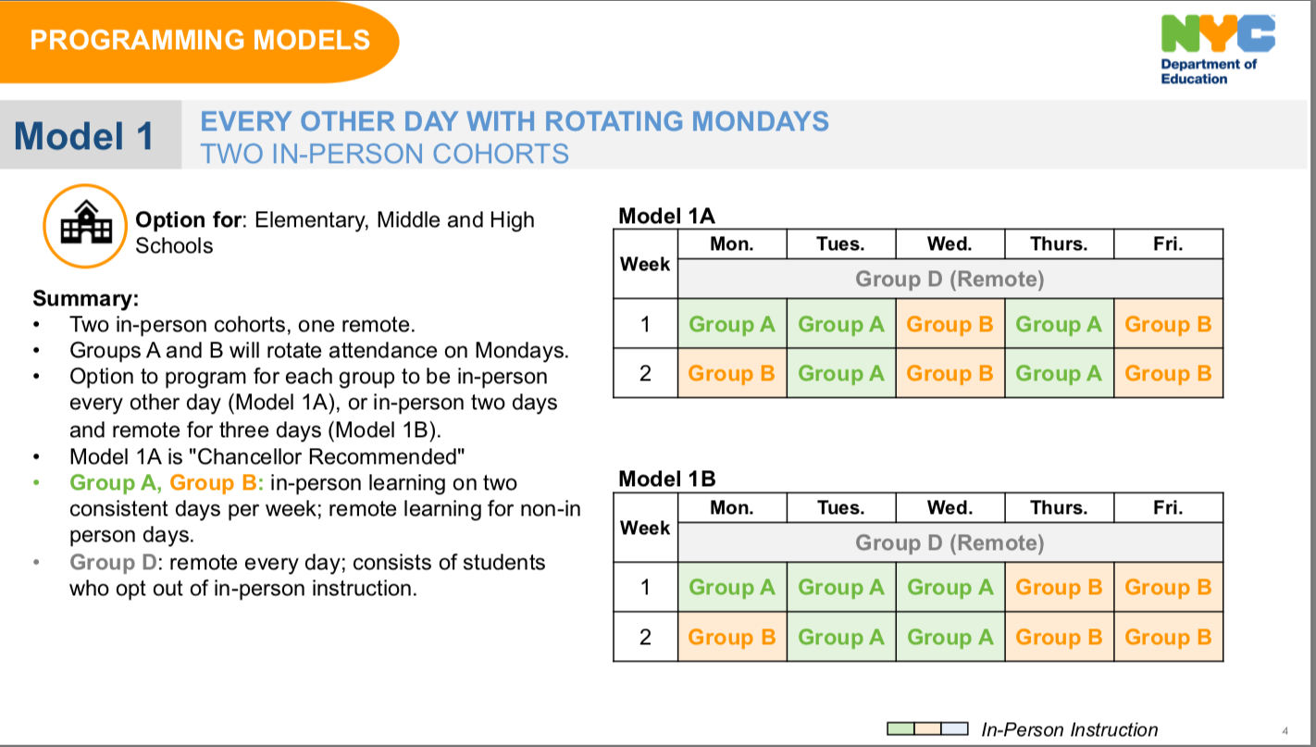
PS 108 Space Data
With social distancing, median range of 9-12 students per classroom (actual number varies by size).
Based on local constraints, schools determined a split model from a set of choices from the Chancellor.
8/28: Schools can notify parents
8/28: School plans are posted

Slide 32
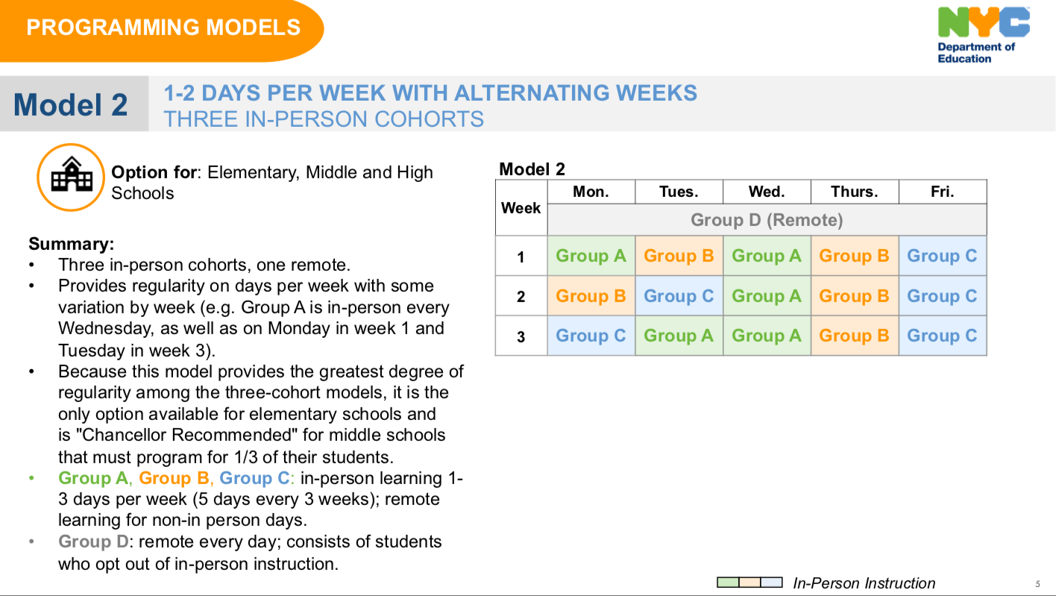

Slide 33
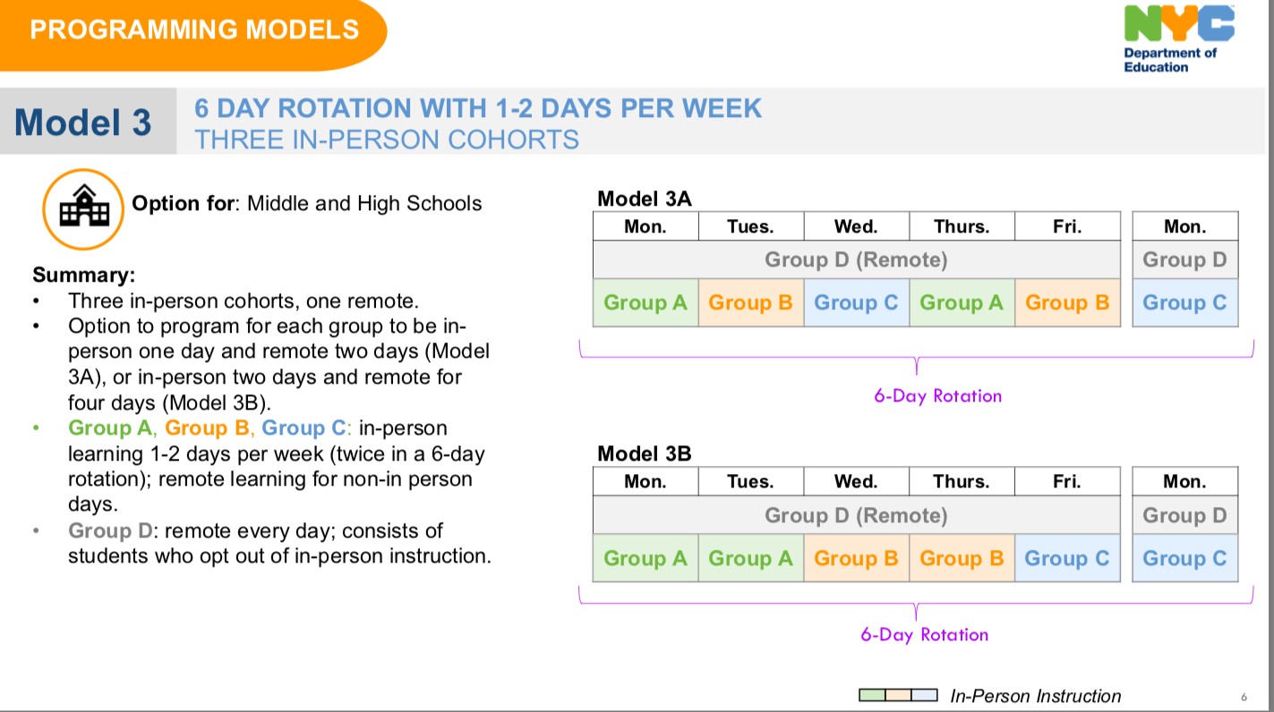

Slide 34
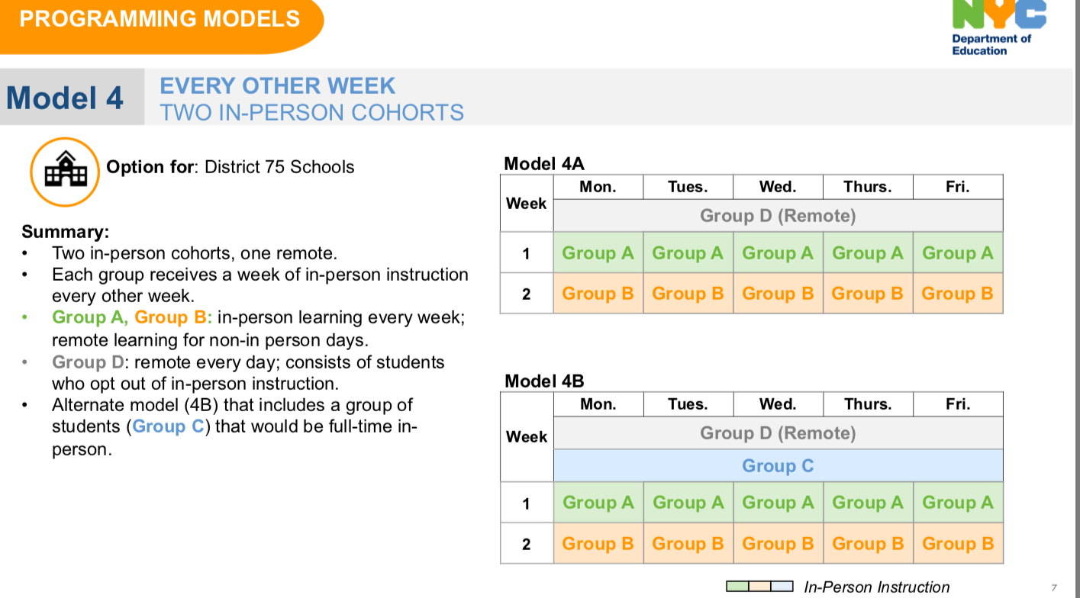

Slide 35
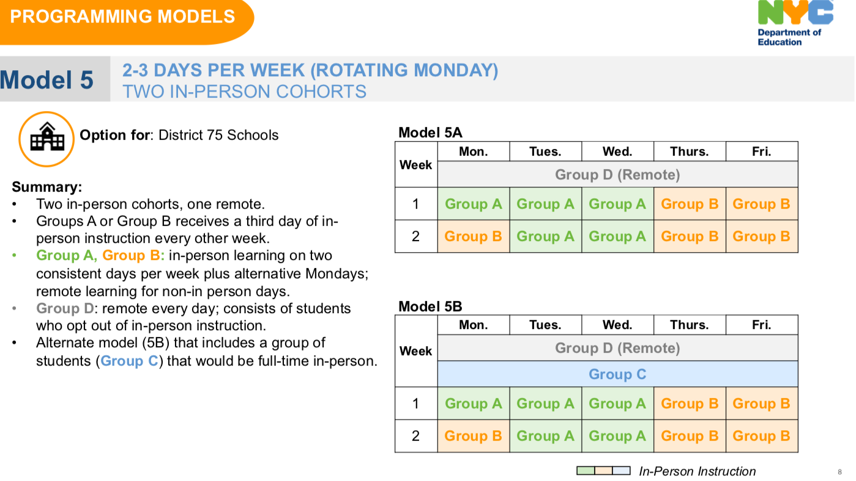

Slide 36
Frequently asked questions
Will remote learning have more "live" teaching than it did last year?
2. Will the school be safe for the children?
3. Will there be safety protocols put in place? Some cannot make decisions unless they know the plan.
4. How many children will be in each class?
5. Will masks be required all day?
6. Will they be able to switch from blended learning to remote and vice versa at any point throughout the year?

Slide 37
THANK YOU!!

