Slide 1



Slide 2
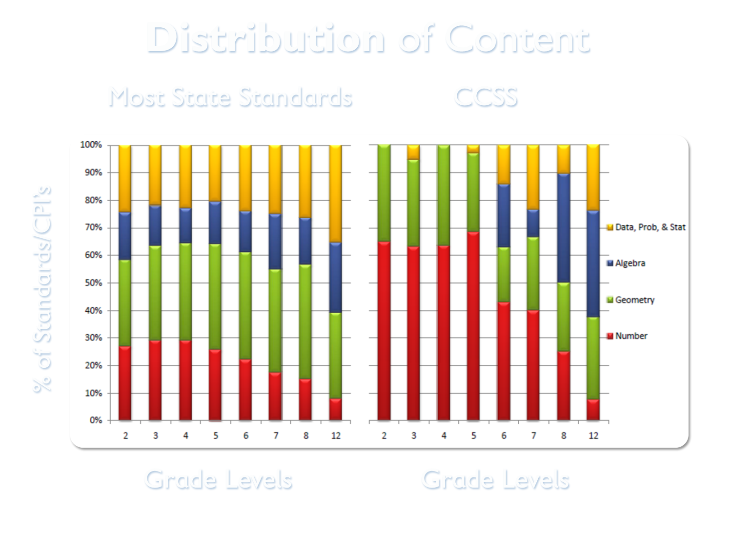
Notes:
This chart includes two parts: How we used to teach math on the left and what the Common Core is asking on the right. Have parents compare the two charts.
Red represent Number and Number Sense
Green – geometry
Blue – Algebra
Yellow – Data, Probability, and Statistics

Slide 3
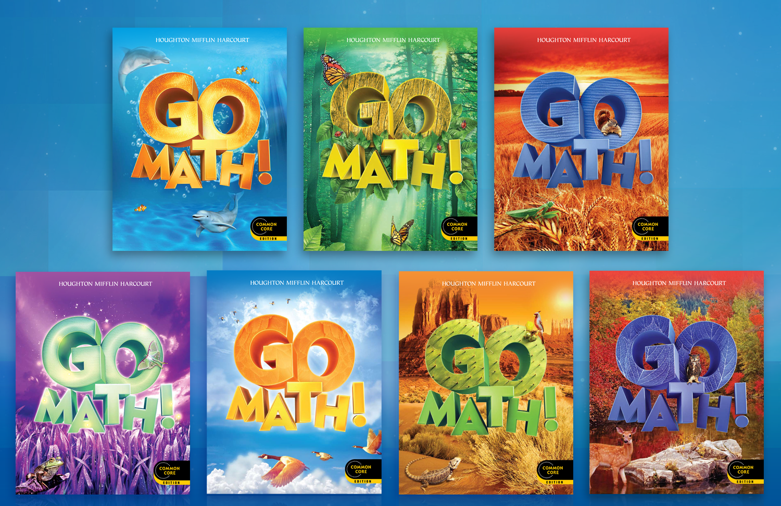
Organization
Notes:
My name is <Blank> and I am delighted to be here today to present to you Go Math. Go Math is an exciting new program, built for the Common Core State Standards, that enables students to transfer these 21st century skills (communicating, taking risks, and problem solving) to the classroom and beyond.

Slide 4
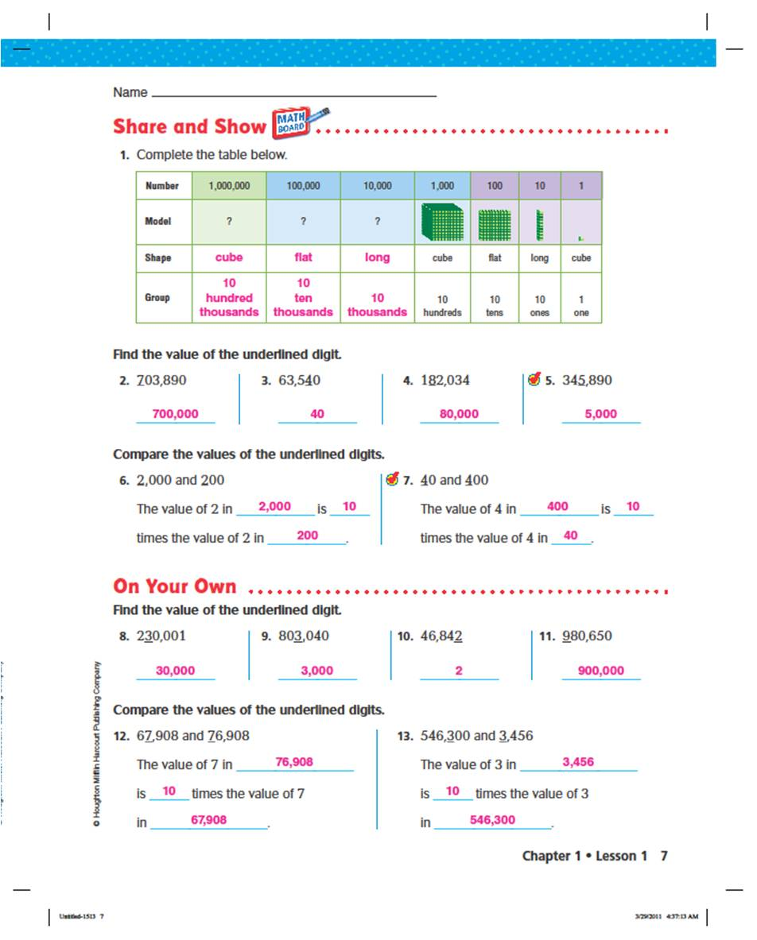
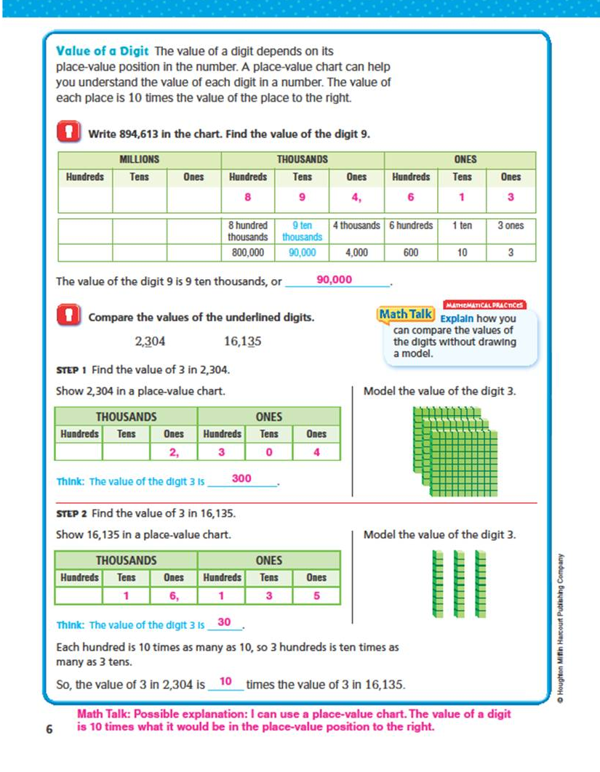
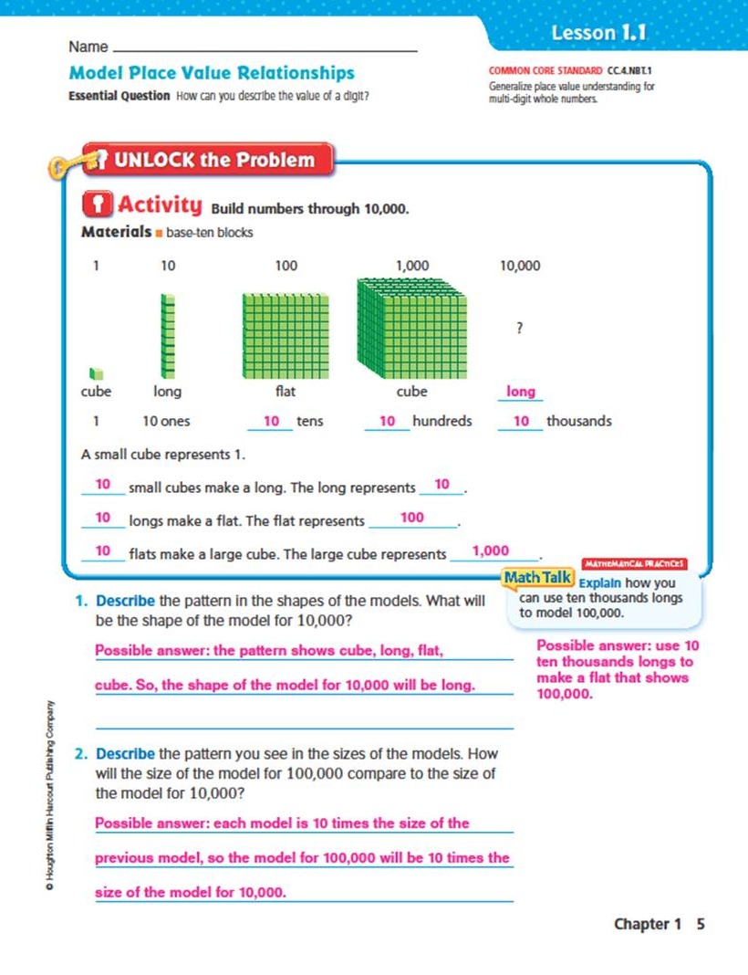
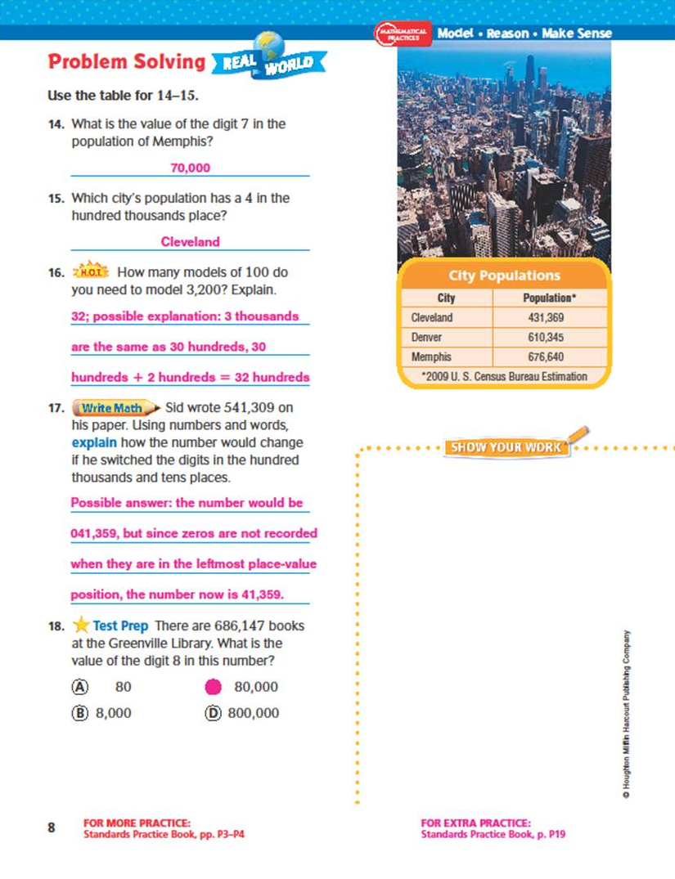
4 part lesson
Notes:
Each lesson has 4 parts, Listen and Draw (K-2) or Unlock the Problem (3-5), Share and Show, On Our Own, and a Problem Solving piece that connects to the real world.
Embedded Mathematical Practices, Essential question
Highlight Math Talk

Slide 5
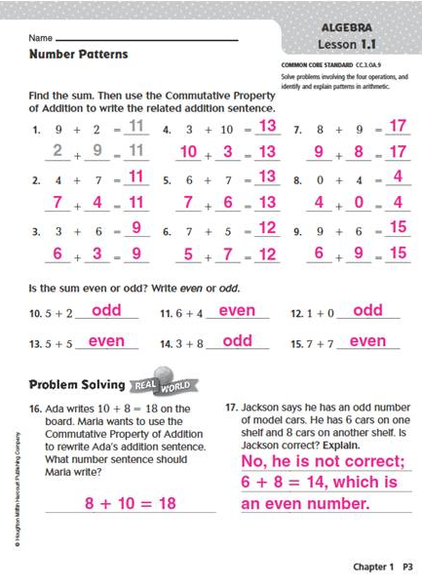
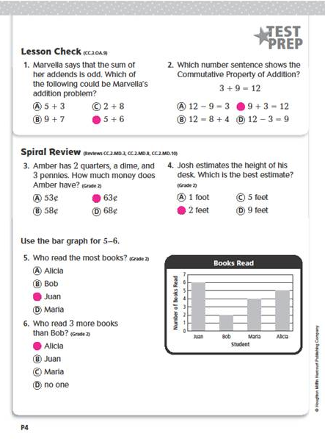
Standards Practice Book
Notes:
Every lesson is followed with one page of additional lesson practice and one page of spiral review in test prep format.

Slide 6
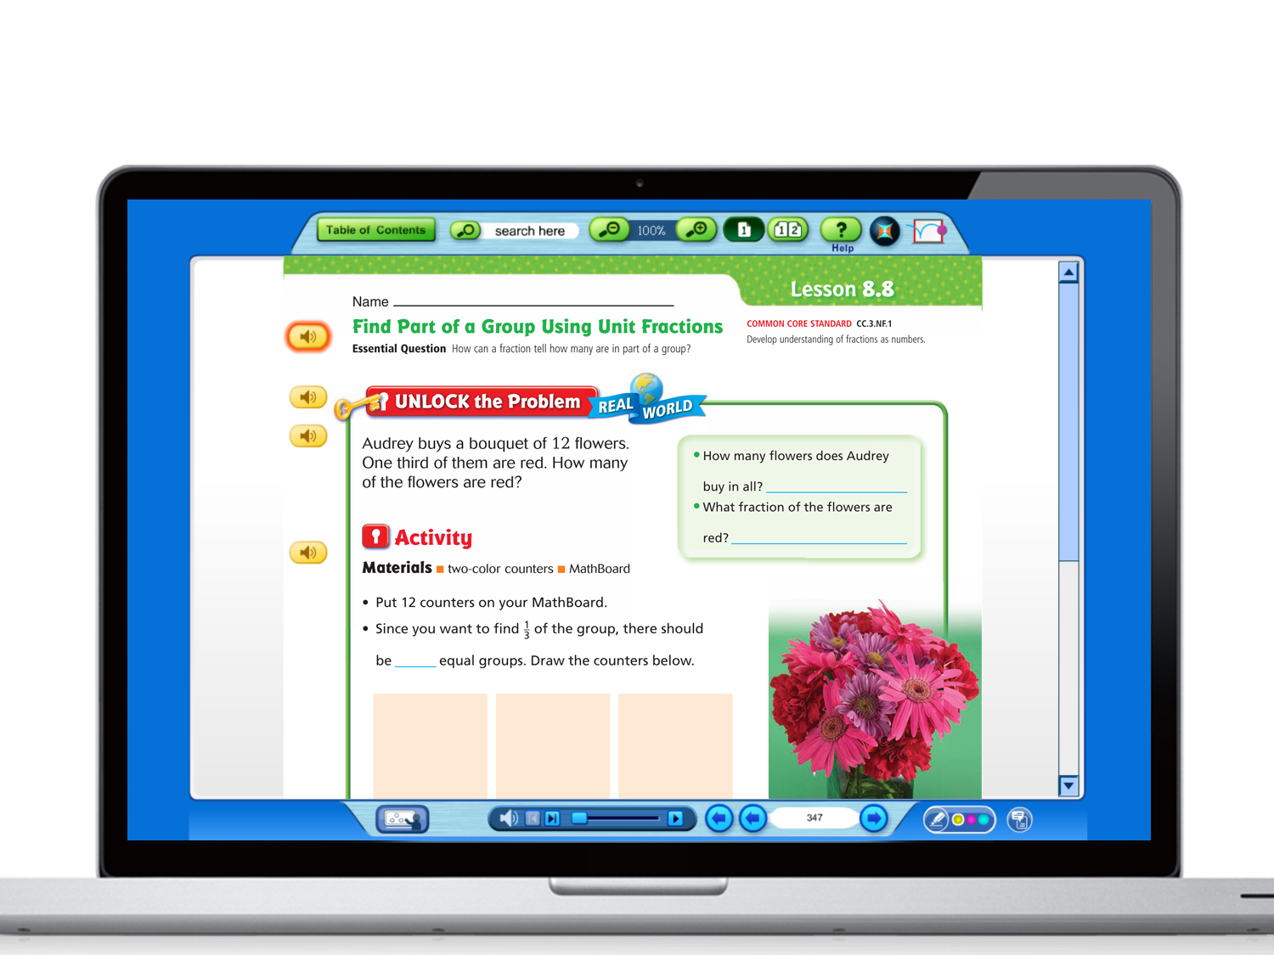
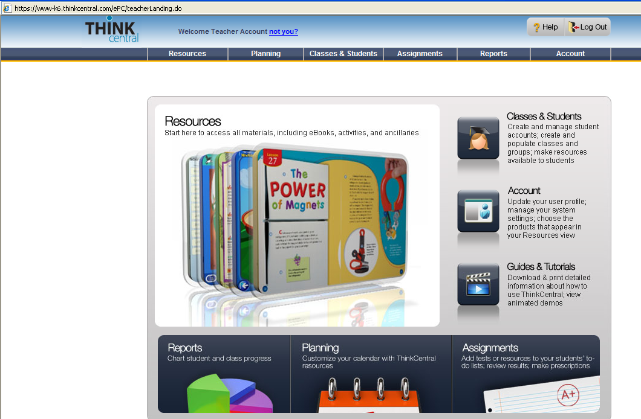
www-k6.thinkcentral.com
Notes:
Demo of Online Resources
Note to Presenter: Suggest Grade 4 Lesson 6.2 OR Grade 1 Lesson 2.4. Both of these have links for all 3 tools (Destination Math, Animated Math and iTools).
Go to the online SE and start by clicking on Chapter outline. Then click on a lesson to review the lesson format we saw in the slides previously.
From the lesson you choose (see above), demo each of the following explaining their purpose:
Destination Math—step-by-step modeling helps students master concepts and skills; motivating audio and animation ensure student engagement
Animated Math Models--Curious George (K-2) and Carmen Sandiego (3-6) characters introduce lesson activities with audio and animation; concepts are modeled and reinforced with feedback
iTools- virtual manipulatives- solve problems with interactive digital manipulatives; model and explore math lesson concepts
Mega Math –provides additional lesson practice with engaging activities that include audio and animation
NOTE TO PRESENTER:
Have Think Central open in another window and ready to go. Use Alt Tab to move from PowerPoint to website.

Slide 7
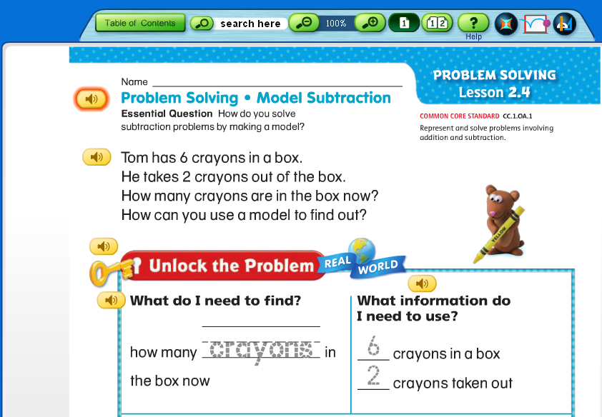



Online Student Edition
Destination Math
Animated Math
iTools
Notes:
HIDE SLIDE IF ONLINE
These tools can be accessed at point of use for a lesson. This eliminates guessing and searching of tools from the resource page. Let’s take a closer look at each of these digital tools.

Slide 8
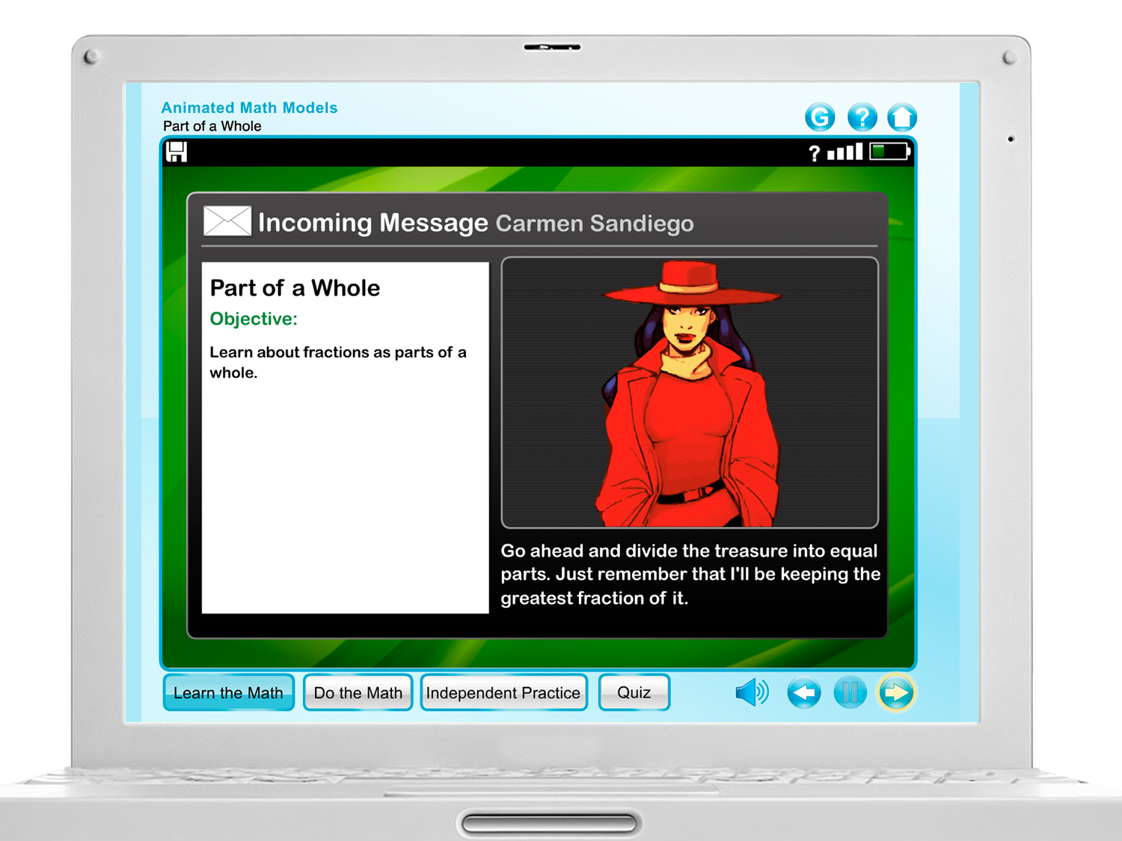
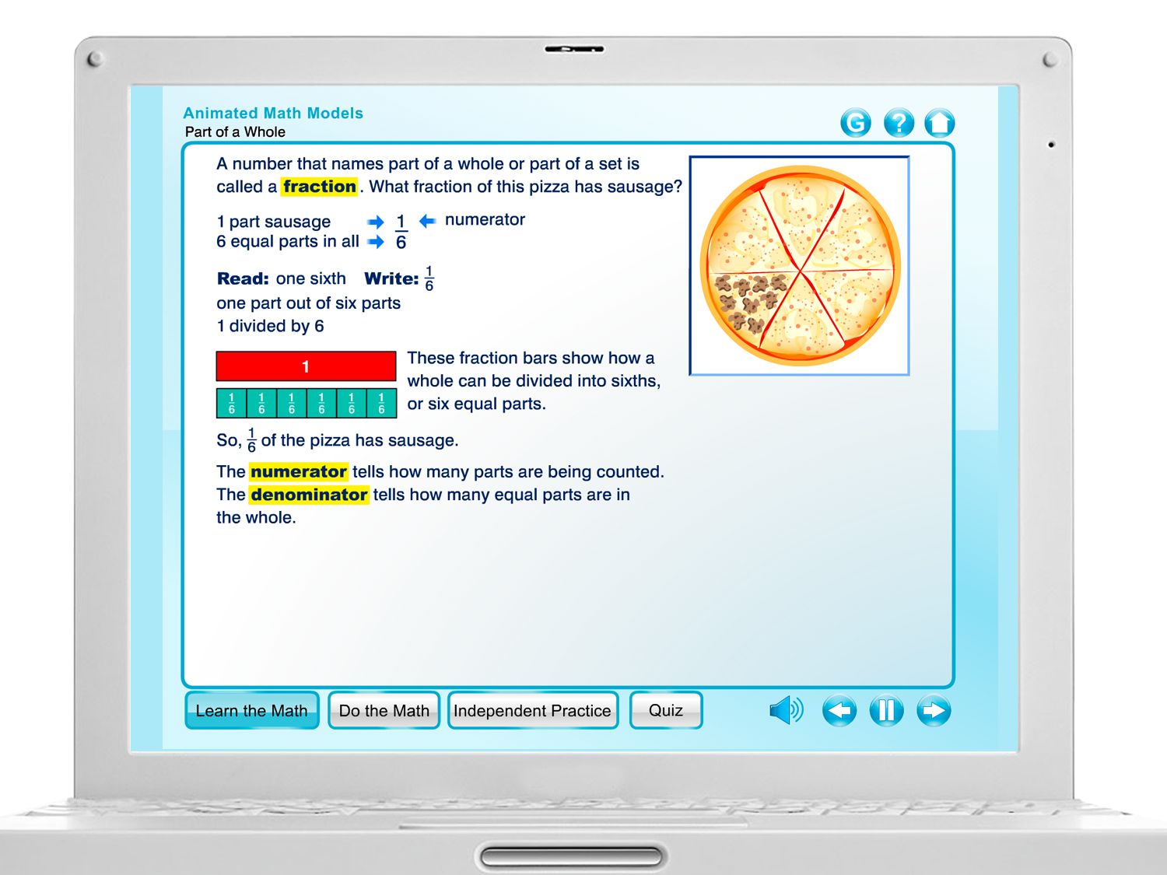
Notes:
Carmen Sandiego characters introduce the lesson activities with audio and animation and then concepts are modeled and reinforced with feedback. (Demo live or show camtasia).

Slide 9
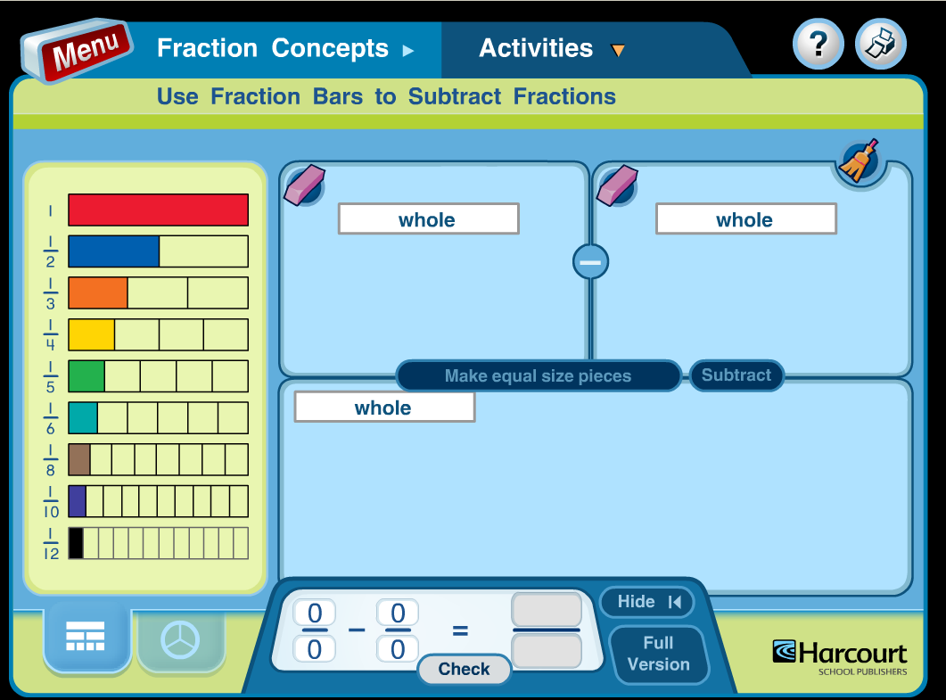
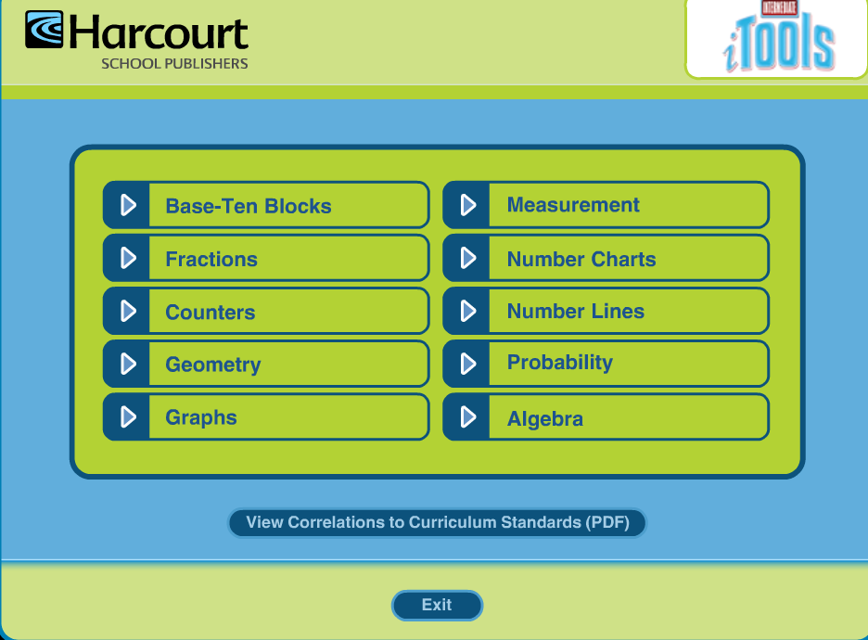
Notes:
HIDE SLIDE IF ONLINE
itools offer virtual manipulatives and modeling activities that can be used in whole class or small group instruction. And remember since it is web based, students can access it from home as well. What a great way to help with homework!

Slide 10
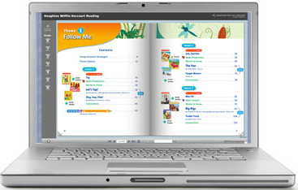
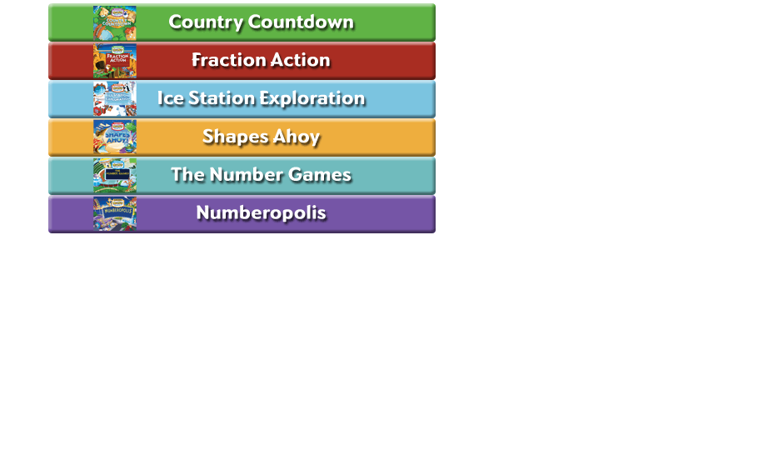
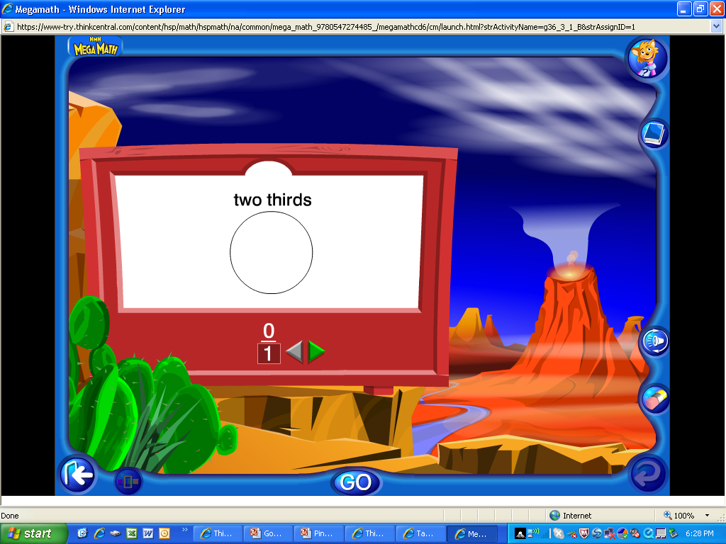
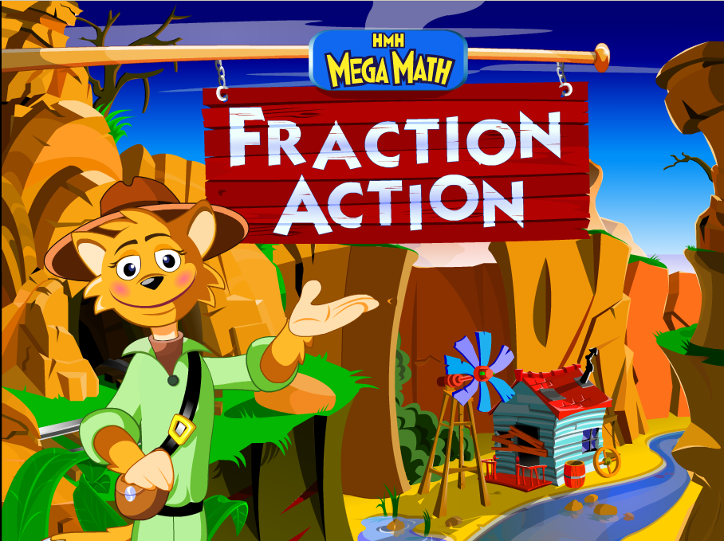
Mega Math
Notes:
HIDE SLIDE IF ONLINE
Mega Math offers math adventures that help students practice skills and apply concepts. It’s great for center activities or independent work.

Slide 11
Notes:
Thank you!

