Slide 1
PS 108
Looking at Mathematics
Presenter: Antoinette Ulrich, AIS Math

Slide 2
What’s New? What’s Changing?
NYS Mathematics Standards (2005) vs. Common Core Learning Standards (CCLS):
  Going deeper in content
  Teaching Less, Learning More
  Emphasis on Fluency, Understanding and Application

Slide 3
WHY CCLS?
Provides K-5 students with a SOLID foundation in whole numbers, multiplication, division, fractions and decimals
Builds on the best state standards and helps to develop consistency among the states
Stresses conceptual understanding and not only procedural skill
Clear expectations across the country for teachers, parents and students
Designed to ensure graduating high school students are prepared to go to college and enter the work force

Slide 4
Six MATH Shifts in CCLS
FOCUS: Teach Less, Learn More
COHERENCE: Students build on previous years’ learning
FLUENCY: Speed/Accuracy with Facts (4 operations)
DEEP UNDERSTANDING:
        emphasize WHY not WHAT
APPLICATION: ability to APPLY what they know
DUAL INTENSITY:
        Balance between skill building and problem solving

Slide 5
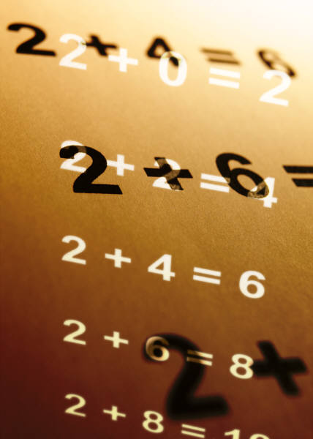
CCLS Timeline:
2011-2012
  Integration of the standards within math instruction
  NYS Math Exam based on current state standards
2012-2013
  Ongoing rollout of CCLS
  NYS transitional tests aligned to CCLS
2013-2014
  Full implementation of CCLS in schools
2014-2015
  PARCC assessments (if adopted by Board of Regents)
    Basis for high quality assessments

Slide 6

Math Instruction at PS 108
Everyday Math Program Grades 2, 4 and 5
  Spiraled Curriculum Structure
enVision Math Program Grades K, 1 and 3
  Mastery Structure

Slide 7
Problem Solving at PS 108
Looking at Student Tasks: NYC DOE directive
Introduction of Math Task Notebook/Folder School-wide
  Focus on open-ended tasks and articulation of mathematical thinking
  Four Square Model Template

Slide 8

Helping Our Students At Home:
Parent and School Connection
Helping My Child Succeed in Math
  Mastery of the Basic Facts
  Emphasis on Explaining Mathematical Thinking
  Math Websites
  Math Is All Around You…Find it, Use it!

Slide 9
MATHEMATICS AT HOME
A Mathematical Environment
(taken from: Family Math, Stenmark, Thompson and Cossey (1986) Chapter One)
Let Your Child Know That You Believe They Can Succeed
Be Ready to Talk With Your Child About Mathematics and Listen To What They Are Saying
Be More Concerned With The Processes of Doing Mathematics Than With Getting A Correct Answer

Slide 10
MATHEMATICS AT HOME
A Mathematical Environment (continued)
Try Not To Tell Children How To Solve The Problem
Practice Estimation With Your Child Whenever Possible
Don’t Expect That All Homework Will Be Easy
Try Not To Drill Your Child on Math Content
Above All, Enjoy Mathematics!
(taken from: Family Math, Stenmark, Thompson, Cossey (1986) Chapter One)

